Slide 1


Data Requests Monitoring System
ETA Unit

Slide 2
Data Requests Monitoring System
The Data Requests Monitoring (DRM) System is designed to manage and monitor data requests, and their deadlines within ECA.

Slide 3
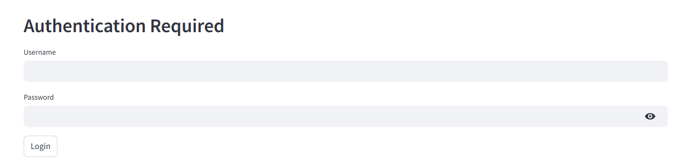
Secured logging in
The system requires authentication for login.
Users are given their own accounts and passwords.

Slide 4
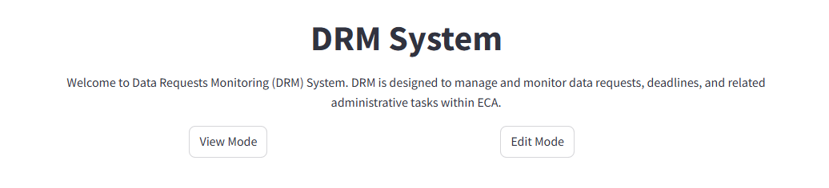
Logging in
Upon logging in, the system is structured into two modes:
In View mode, the user is able to view the main dashboard.
In Edit mode, the user is able to edit the data.

Slide 5
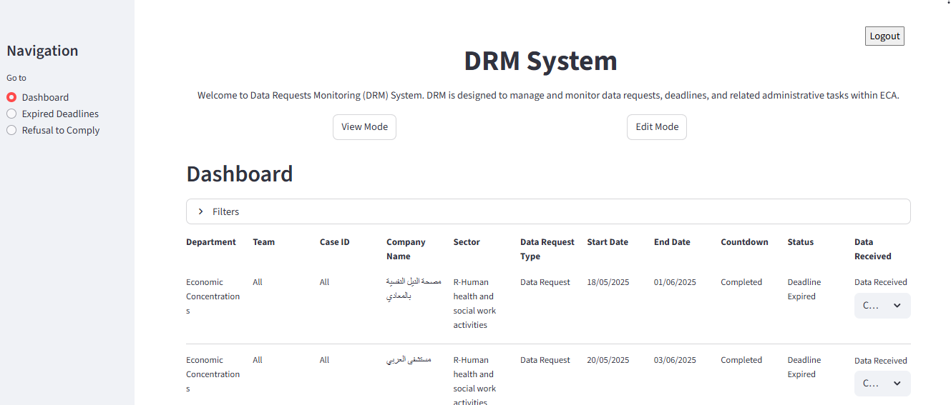
View Mode: Dashboard
The main dashboard shows all the data requests across all departments and their relevant deadlines.
The user can apply “Filters” by department, Case ID, Team, Sector, etc to view such information.
The user can directly update in the main dashboard the status of the data as “complete”, “incomplete” or “no reply”

Slide 6
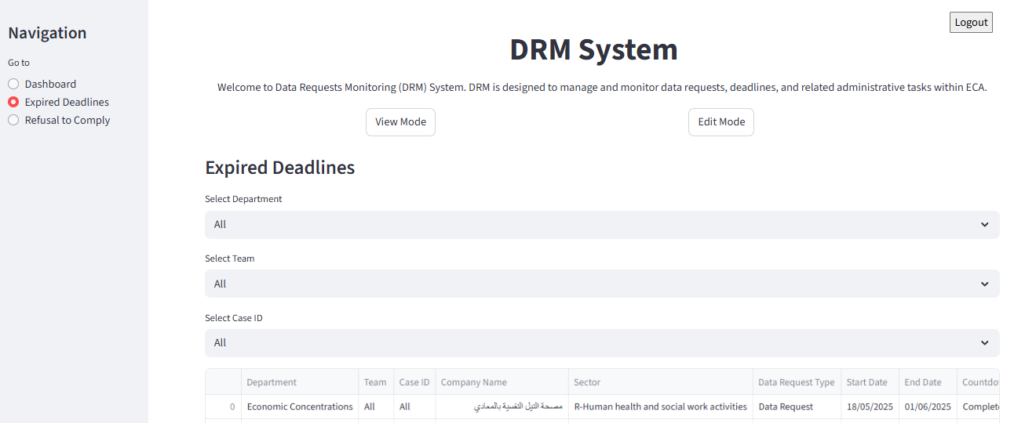
View Mode: Expired Deadlines
This tab includes all expired deadlines.

Slide 7
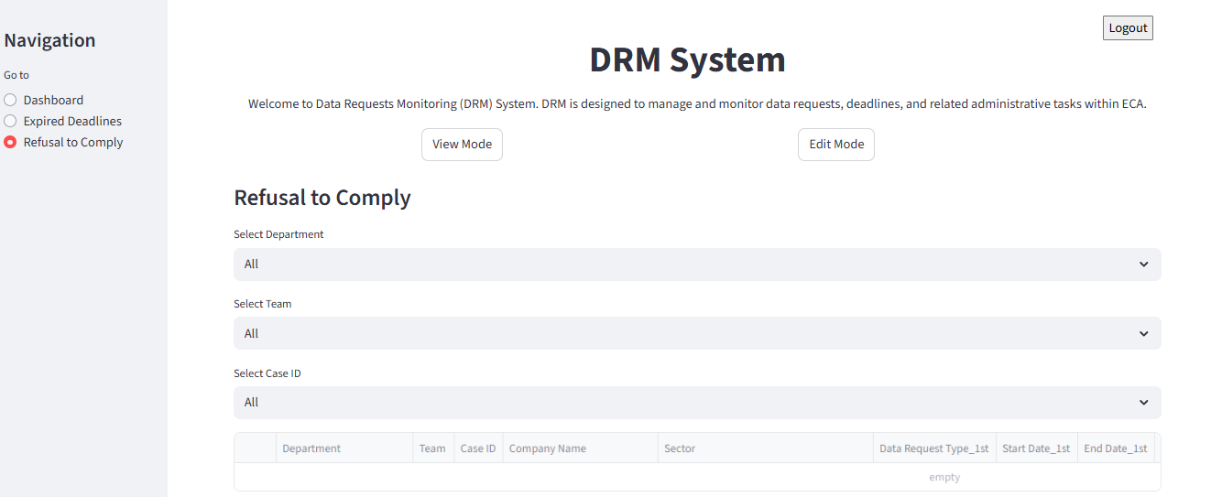
View Mode: Refusal to Comply
This tab includes refusal to comply cases where companies sent:
Data request and data status updated as “no reply”
First reminder and data status updated as “no reply” and
Second reminder and data status updated as “no reply” would b automatically added to this tab.

Slide 8
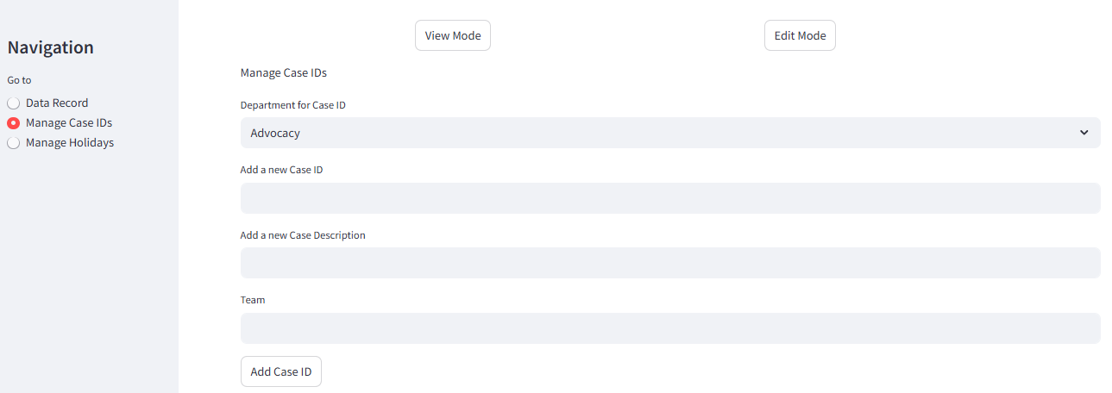
Edit Mode: Manage Case ID
Users must register the Case ID for the first time in this tab.

Slide 9
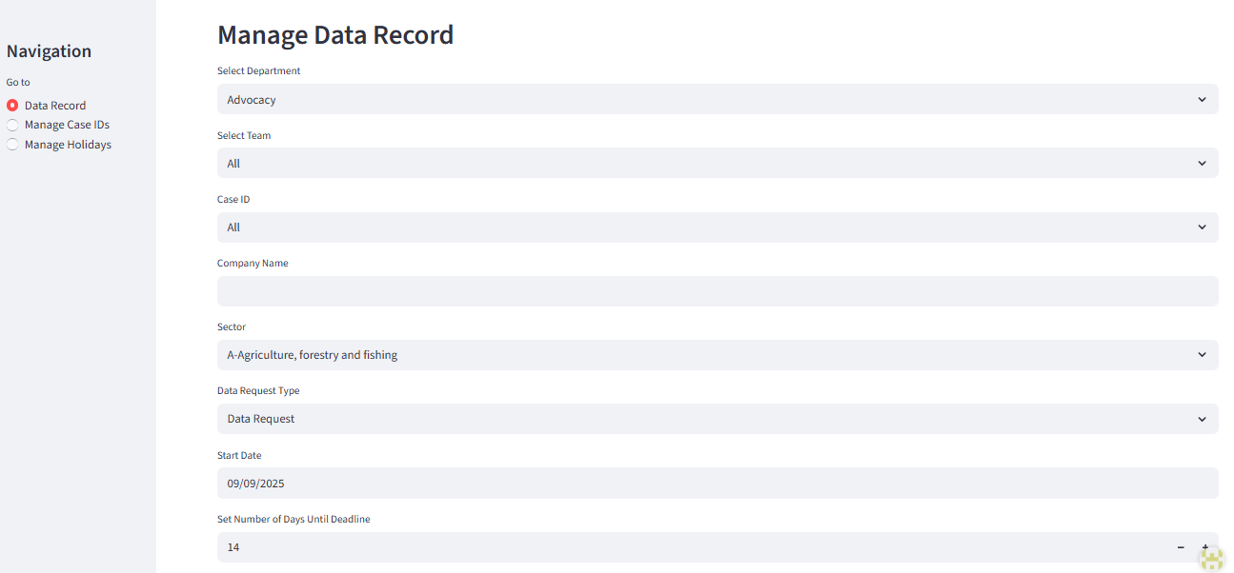
Edit Mode: Data Record
Upon registering Case ID information, the user can then proceed to this tab to add the data requests information.
Specify sector according to ISIC Classification
Types include: Data request, 1st reminder, 2nd reminder, Data completion, Data extension
The count starts from the next day of the specified “Start Date”
The number of days set is in calendar days

Slide 10
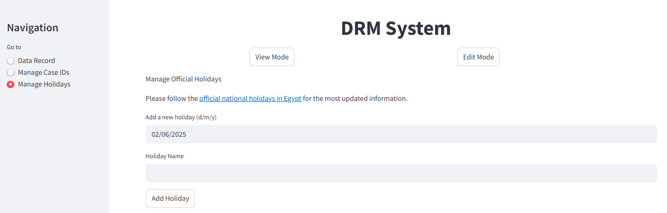
Edit Mode: Manage National Holidays
Official holidays affect the data request deadlines and are included in this tab.
Coordination with admins is vital to ensure the deadlines on the system correspond with the deadline included in the official data requests letters.

Slide 11
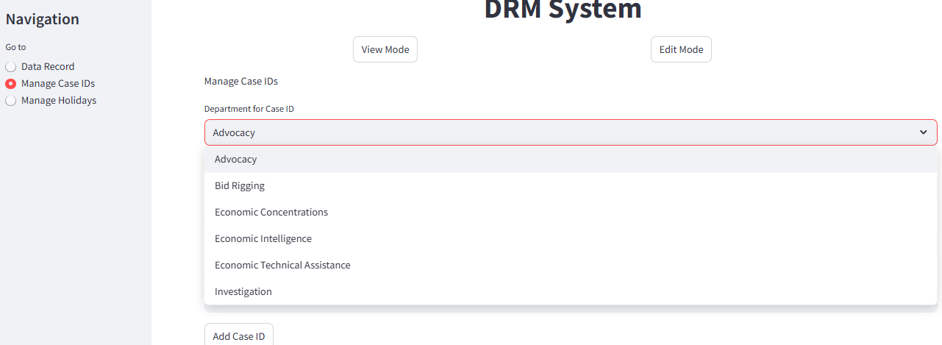
Example: Registering Case ID
**Minor differences may be found in the following example due to updates done to the system.

Slide 12
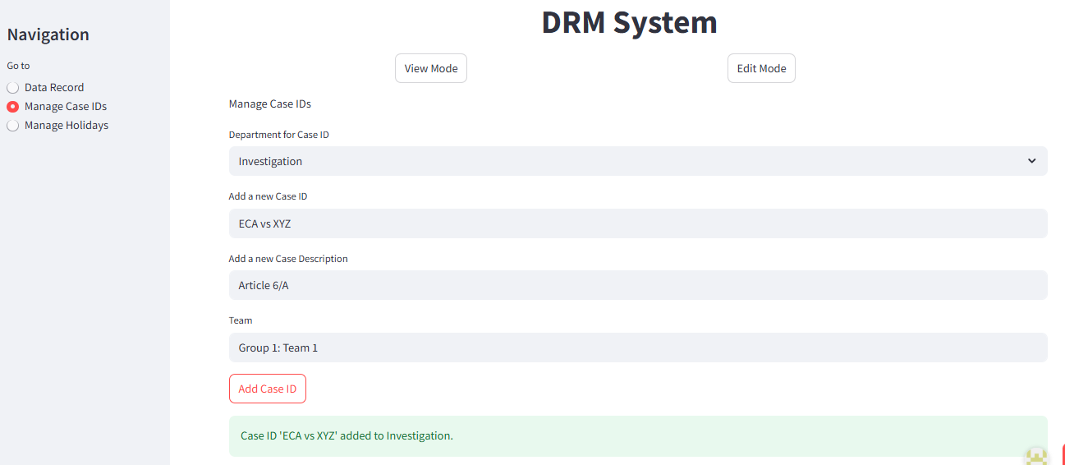
Example: Registering Case ID

Slide 13
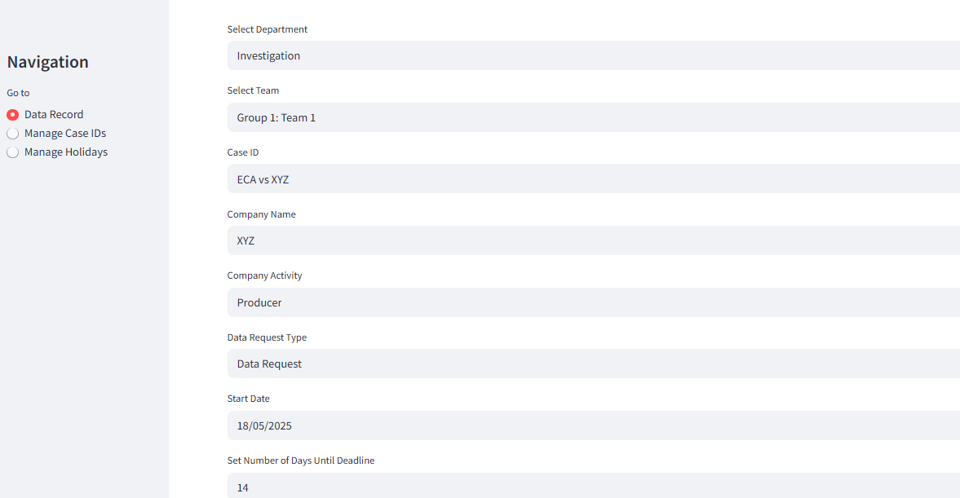
Example: Adding Case Details

Slide 14
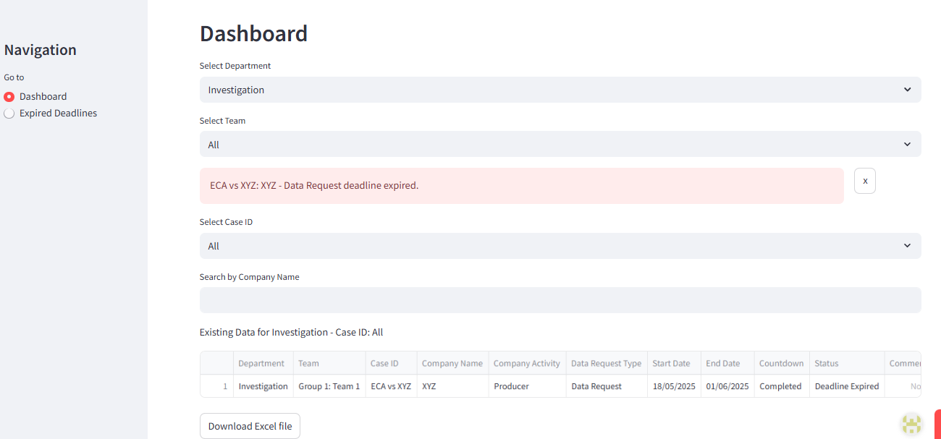
Example: Cases Dashboard
The system generates automatic warning notifications with expired deadlines and lasts for two days before disappearing
The deadline automatically adjusts in case of national holidays

Slide 15
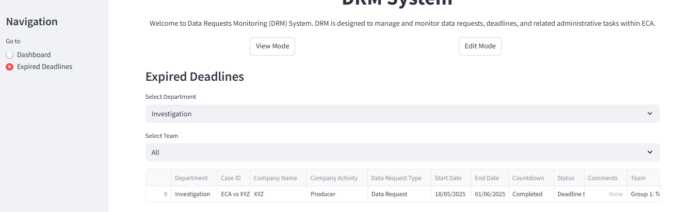
Example: Expired Deadlines

